Slide 1


Case in Point:
Area, Scatter and Bubble
Chengjun Liu

Slide 2
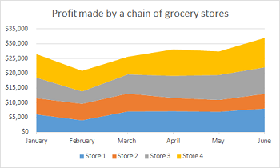
Area Graph
Explicitly show the comparison of amount and sum(Area).
Scan: We are comparing 4 stores’ profit, ranging from January to June, all time stable from $5000 to $30000
Extract: Apparently Store 1 overtakes the others. There is a slight growth after February for 4 stores. Store 1 and Store 2 contribute more growth. The difference becomes a slightly larger
Apply: Store 1 and Store 2 tend to have stable competence

Slide 3
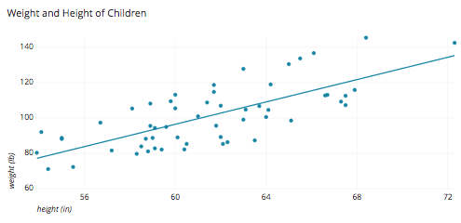
Scatter Graph
The scatter, possibly with a fitted line, explicitly shows relationship between two factors.
Scan: Each point shows one height versus one weight. Height is higher, weight seems to be higher.
Extract: The fitted line is natural with points, showing the relationship between height and weight is similar with the line. Height and weight indeed has a positive relationship
Apply: We can use the relationship to estimate children’s proper height and weight, controlling body weight and health.

Slide 4
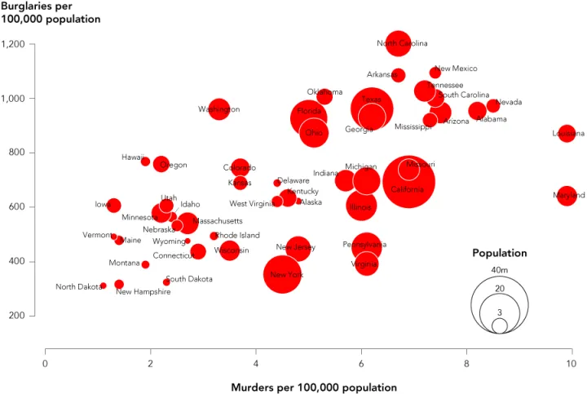
Bubble Graph
Bubble volumes show third dimension of information.
Scan: We can see burglaries and murders of states from axes. Bubble size also shows populations.
Extract: Beside the positive relationship of burglaries and murders, population also has relationships with crime.(Small bubbles are lower left, big bubble are upper right.) New York seems to be better than other big bubbles.
Apply: For safety needs, we suggest living in smaller states. New York is also a good choice for safety.

